Slide 1


Computer Organization & Architecture
Chapter 2
Computer Evolution and Performance

Slide 2
2.1 A Brief History of Computer
4 generations from computer birth
  1950 ~ 59 Vacuum tube
  1960 ~ 68 Transistor
  1969 ~ 77 Integrated Circuits
  1978 ~ ? Large-scale integration (LSI) and Very-large-scale integration (VLSI)
  2009~? Intelligence

Slide 3
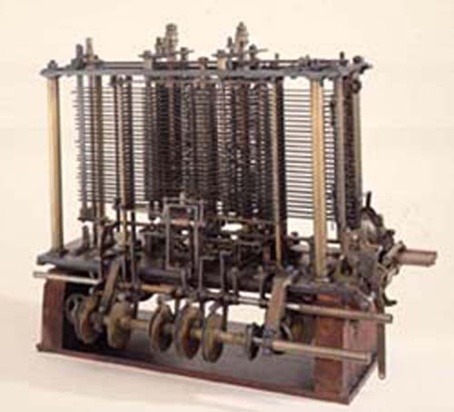

Computer Pre-history
Analytical Engine
Charles Babbage
Application – Mathematical Tables (Astronomy) and Nautical Tables (Navy)
Background – Any continuous function can be approximated by a polynomial
Technology – mechanical gears, Jacquard’s loom,
simple calculators

Slide 4
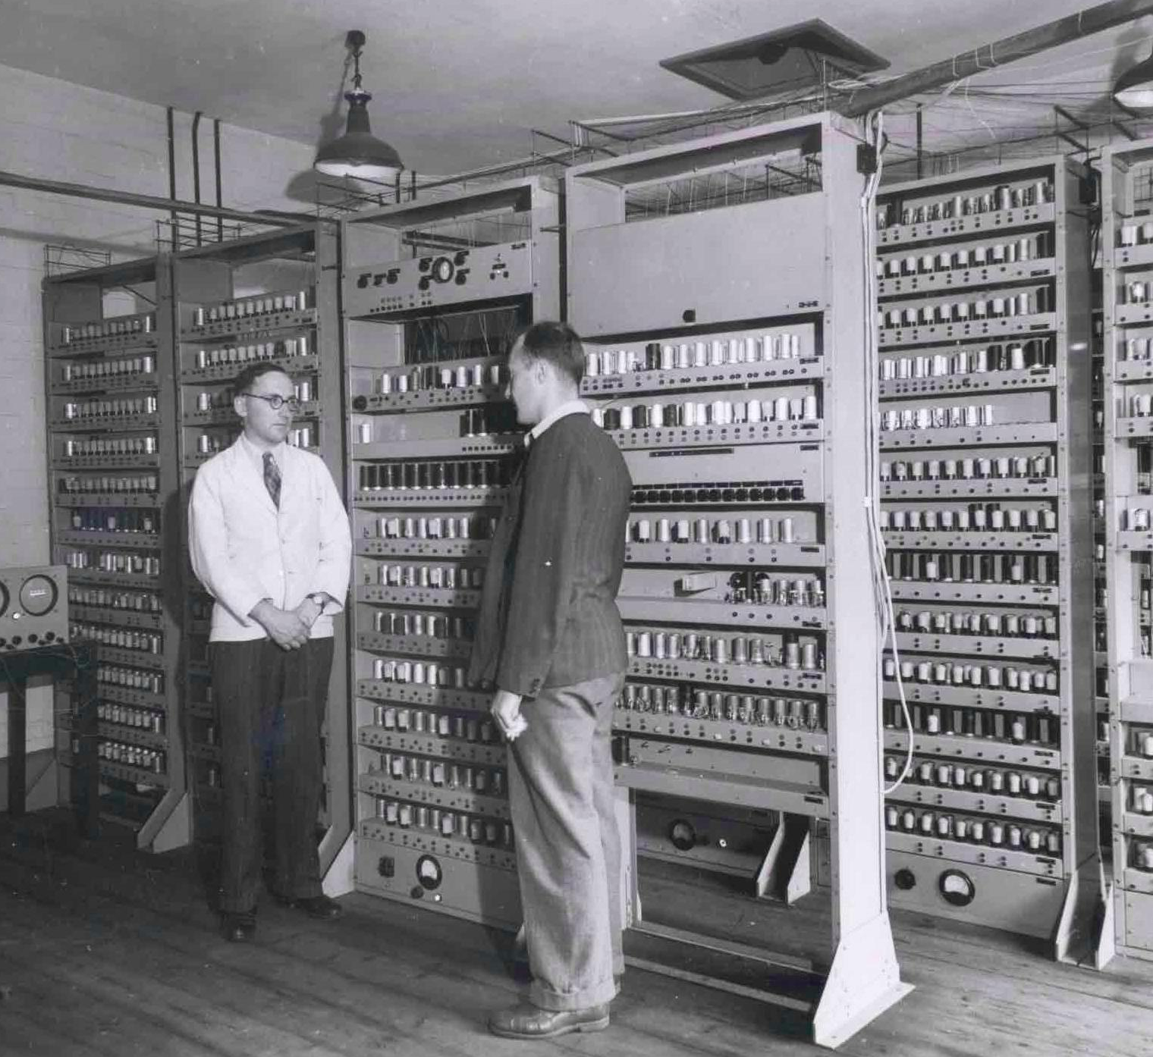
Vacuum tube Computer
The first general-purpose computer：ENIAC
Electronic Numerical Integrator And Computer
Started 1943 and Finished 1946.
J.Presper Eckert &
John Mauchly
University of Pennsylvania
Used until 1955
Can conditional Jump and be programmable, distinguished it
from earlier ones
Used for computing artillery firing tables

Slide 5
Vacuum tube Computer
ENIAC - details
  Decimal (not binary)
  20 accumulators of 10 digits
  Programmed manually by switches
  18,000 vacuum tubes
  30 tons
  15,000 square feet
  140 kW power consumption
  5,000 additions per second

Slide 6
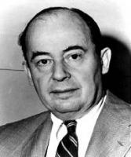
IAS
Von Neumann/Turing
  Begin 1946, but not completed 1952
  Stored program concept
  Main memory storing programs and
  data
  ALU operating on binary data
  Control unit interpreting instructions
  from memory and executing them
  Input and output equipment operated by control unit
  Princeton Institute for Advanced Studies – IAS

Slide 7
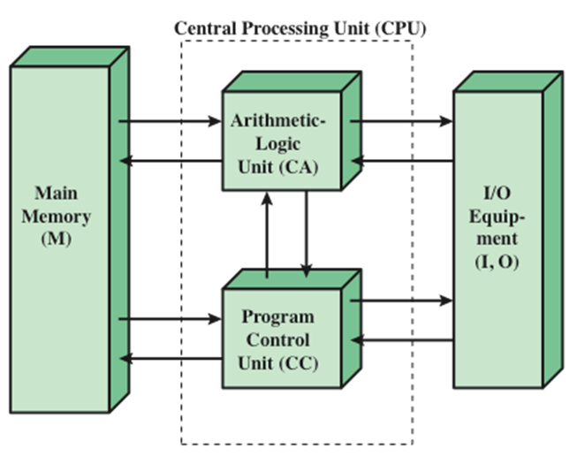
IAS
Structure of the IAS computer

Slide 8
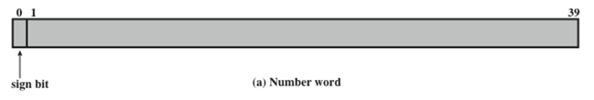
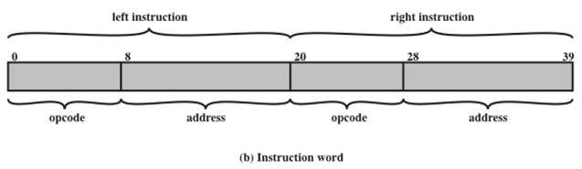
IAS
IAS Memory Formats
  The memory of the IAS consists of 1000 storage locations (called words) of 40 bits each
    Both data and instructions are stored there
    Numbers are represented in binary form and each instruction is a binary code

Slide 9
IAS
IAS Registers
  Memory buffer register (MBR)
    Contains a word to be stored in memory or sent to the I/O unit
    Or is used to receive a word from memory or from the I/O unit
  Memory address register (MAR)
    Specifies the address in memory of the word to be written from or read into the MBR
  Instruction register (IR)
    Contains the 8-bit opcode instruction being executed
  Instruction buffer register (IBR)
    Employed to temporarily hold the right-hand instruction from a word in memory
  Program counter (PC)
    Contains the address of the next instruction pair to be fetched from memory
  Accumulator (AC) and multiplier quotient (MQ)
    Employed to temporarily hold operands and results of ALU operations

Slide 10
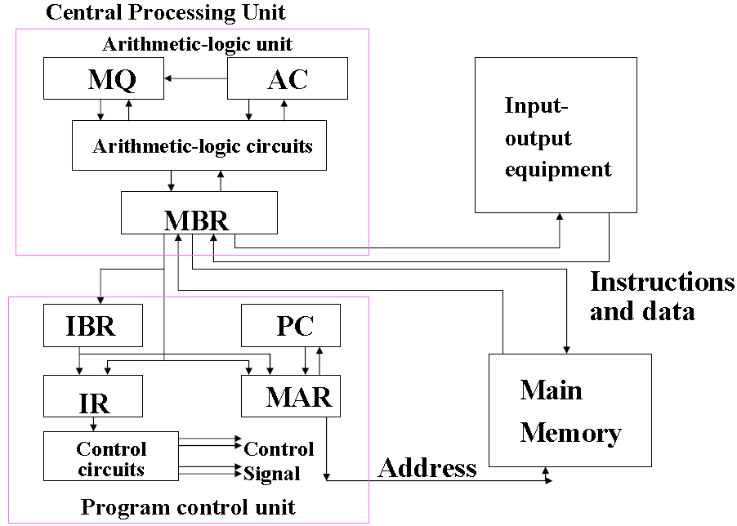
Expanded structure of IAS computer

Slide 11
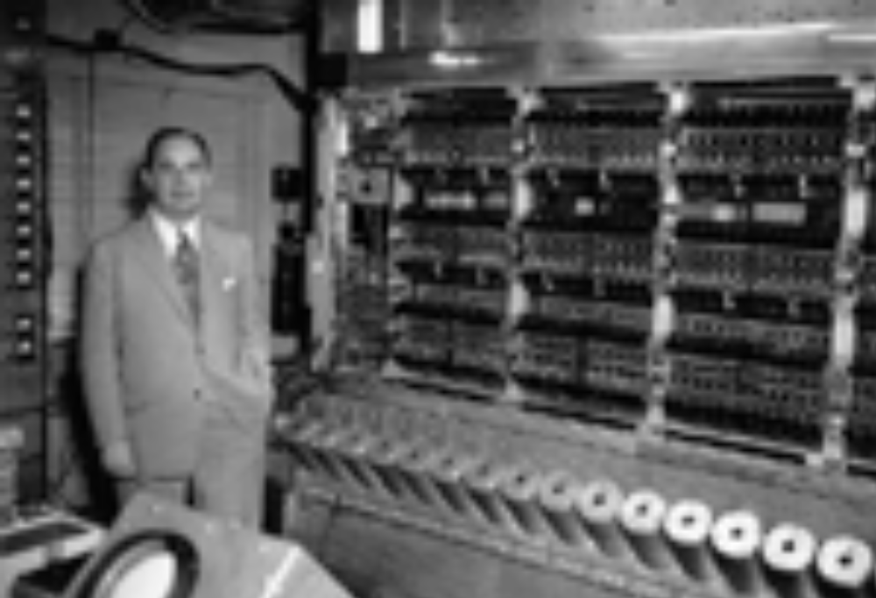
IAS
IAS: Institute for Advanced Study (1952)

Slide 12
Ch.2-2.1
IAS Instruction Set
  21 Instructions
  Data Transfer
  Unconditional Branch
  Conditional Branch
  Arithmetic
  Address Modify

Slide 13
Vacuum tube Computer
Commercial Computer
  Later of 1946, Eckert and Mauchly established the first computer company -- Electronic Control Corp.
  Their first successful machine was the Universal Automatic Computer (UNIVAC) I.
  UNIVAC tasks involve scientific and commercial applications

Slide 14
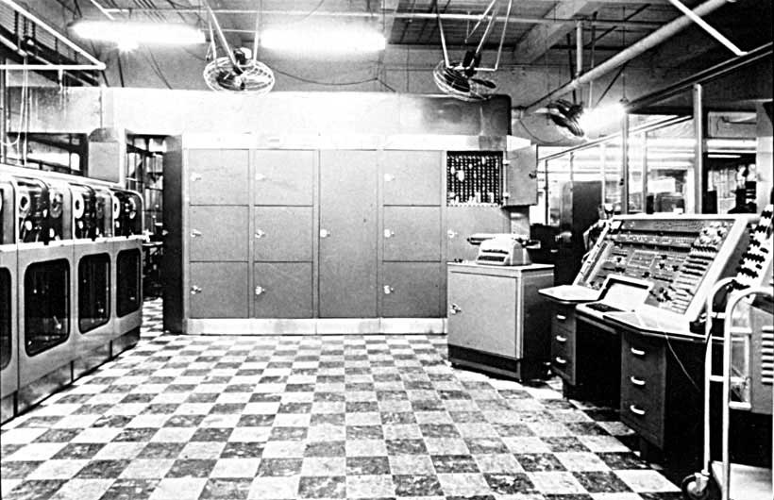
Vacuum tube Computer
UNIVAC-1(1951)

Slide 15
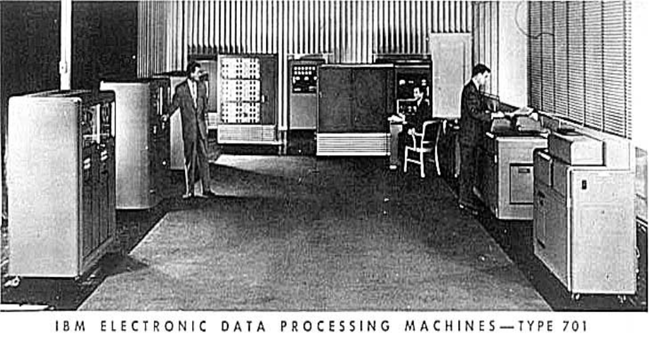
Vacuum tube Computer
IBM 701 (1953)

Slide 16
Transistor Computer
Introduced
  More complex arithmetic and logic units and control units
  The use of high-level programming languages
  Provision of system software which provided the ability to:
    load programs
    move data to peripherals and libraries
    perform common computations
NCR & RCA are front-runners
IBM 7000 series (1952)
DEC (PDP-1: first DEC computer )

Slide 17
Ch.2-2.1
IBM 7094
  The last member of 7000 series in1964
  Memory 2K to 32K of 36 bit words
  Memory Cycle time fell from 30 micro sec to 1.4 micro sec
  Number of Opcodes grew from 24 to 185
  Use of data channels
  Multiplexor to which all channels are connected

Slide 18
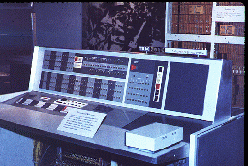
Ch.2-2.1
IBM 7090 Console

Slide 19
IC Computer
Use of Integrated Circuits (IC)
SSI & MSI based computer is the 3rd computer
Examples IBM System/360 and DEC PDP-8
Family concept
  Similar or identical instruction set
  Similar or identical operating system
  Increasing speed, increasing number of I/O ports, Increasing memory size and Increasing cost

Slide 20
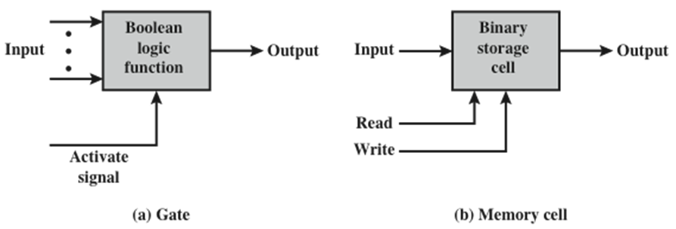
IC Computer
Microelectronics
  In 1958，revolutionized achievement in electronics came: integrated circuit was invented
    The era of microelectronics
  Transistor, resistance, capacitance made from semiconductor，together with whole circuit can be put in a silicon wafer
60s later, small scale integration and medium scale integration came forth

Slide 21
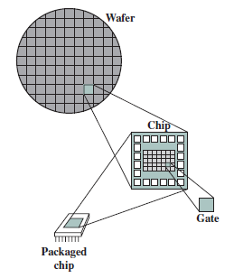
Wafer, Chip And Gate Relationship
IC Computer

Slide 22
IC Computer
Moore’s Law
  1965，Gordon Moore - cofounder of Intel
  Number of transistors on a chip will double every year
  Since 1970’s development has slowed a little
    Number of transistors doubles every 18 months
  Cost of a chip has remained almost unchanged
  Higher packing density means shorter electrical paths, giving higher performance
  Smaller size gives increased flexibility
  Reduced power and cooling requirements
  Fewer interconnections increases reliability

Slide 23
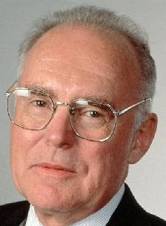
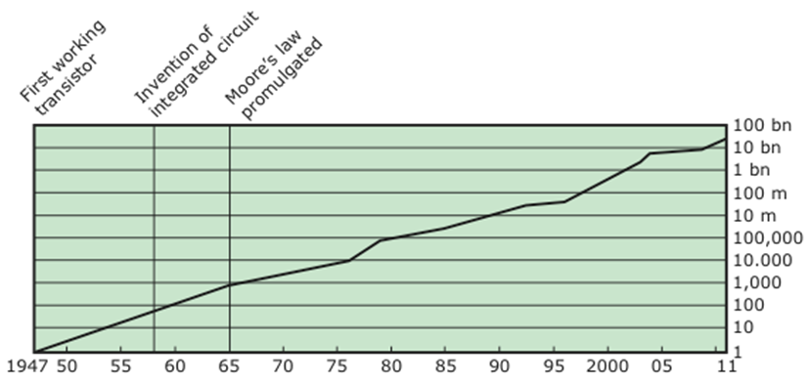
IC Computer

Slide 24
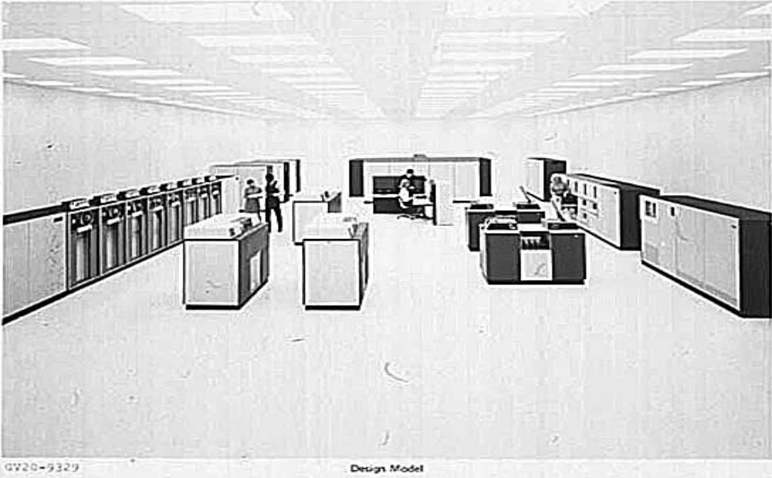
IC Computer
IBM 360: A General-Purpose Register (GPR) Machine

Slide 25
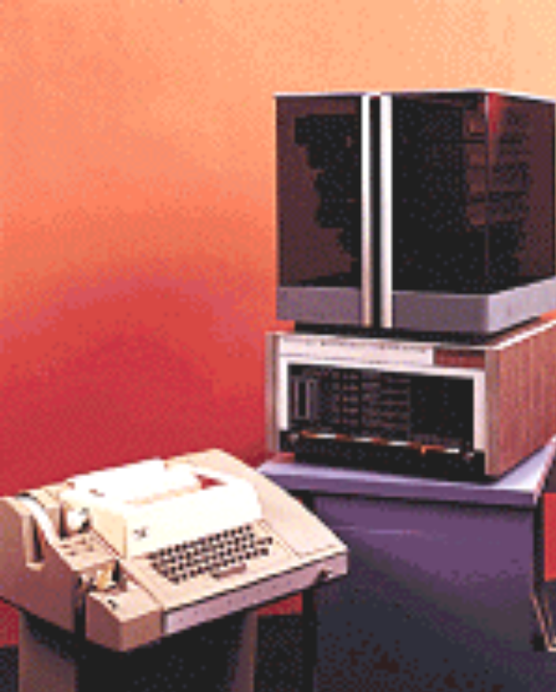
IC Computer
DEC PDP-8 (1965)
  First minicomputer
  Did not need air conditioned room
  Small enough to sit on a lab bench
  $16,000 -$100k+ for IBM 360
  Bus structure

Slide 26
LSI & VLSI Computer
Semiconductor memories
  the first relatively capacious semiconductor memory（1970, Fairchild）
    Size of a single core
      i.e. 1 bit of magnetic core storage
    Holds 256 bits
    Non-destructive read
    Much faster than magnetic core
  Capacity approximately doubles each year
  Since 1970 semiconductor memory has been through 13 generations
    Each generation has provided four times the storage density of the previous generation
    accompanied by declining cost per bit and declining access time

Slide 27
LSI & VLSI Computer
Microprocessors
  1971 Intel developed 4004
    First chip to contain all of the components of a CPU on a single chip
    Birth of microprocessor
  1972 Intel developed 8008
    First 8-bit microprocessor
  1974 Intel developed 8080
    First general purpose microprocessor
    Faster, has a richer instruction set, has a large addressing capability

Slide 28
Quantity and Unit in common use
  Bit -- b
  Byte -- B： 8bit= 2³
  K (Hz, bytes)： 10³ --1024＝2¹⁰
  M: Mega (bytes,Hz)：10⁶ --1024²＝2²⁰
  G: Giga (bytes,Hz): 10⁹ -- 1024³＝2³⁰
  T: tera (bytes，Hz): 10¹² --1024⁴＝2⁴⁰
  P: peta (bytes，Hz): 10¹⁵ --1024⁵＝2⁵⁰

Slide 29
2.2 Designing for Performance
Microprocessor speed
  CPU/memory capacity follows Moore’s law
  The techniques for meet the CPU speed
    Branch prediction
    Data flow analysis
    Speculative execution
  Other critical components speed lags of CPU’s speed
    CPU has to wait
    Bottleneck
    Reduce the whole performance
    Especially, main memory

Slide 30
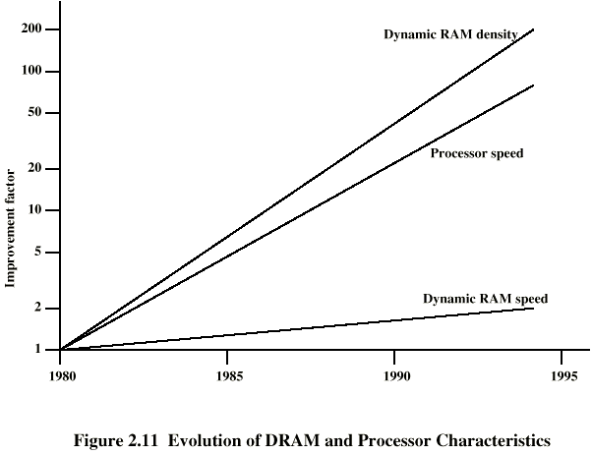
Performance Balance
DRAM and Processor Characteristics

Slide 31
Performance Balance
Solutions
Optimize system structure, balancing the whole performance of CPU, memory and I/O
Improve the interface between CPU and memory
  The interface is the key path responsible for transferring instruction and data
  Increase number of bits retrieved at one time
    Make DRAM “wider” rather than “deeper”
  Change DRAM interface
    Cache
  Reduce frequency of memory access
    More complex cache and cache on chip
  Increase interconnection bandwidth
    High speed buses
    Hierarchy of buses

Slide 32
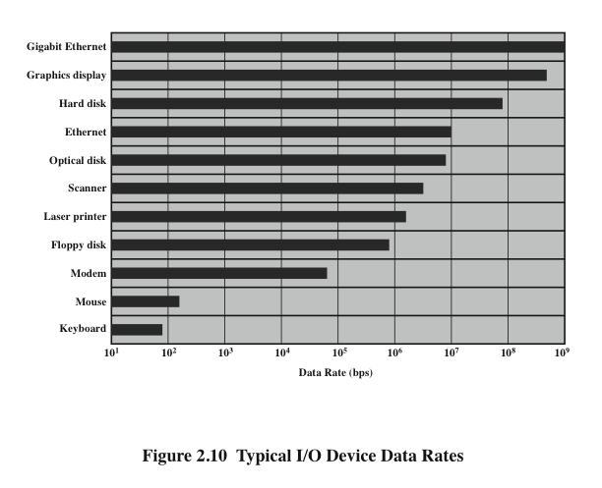
Performance Balance
Notes:
Another area of design focus is the handling of I/O devices. As computers
become faster and more capable, more sophisticated applications are developed
that support the use of peripherals with intensive I/O demands. Figure 2.10 gives
some examples of typical peripheral devices in use on personal computers and
workstations. These devices create tremendous data throughput demands. While
the current generation of processors can handle the data pumped out by these
devices, there remains the problem of getting that data moved between processor
and peripheral. Strategies here include caching and buffering schemes plus the
use of higher-speed interconnection buses and more elaborate structures of buses.
In addition, the use of multiple-processor configurations can aid in satisfying I/O
demands.
The key in all this is balance. Designers constantly strive to balance the
throughput and processing demands of the processor components, main memory,
I/O devices, and the interconnection structures. This design must constantly be
rethought to cope with two constantly evolving factors:
• The rate at which performance is changing in the various technology areas
(processor, buses, memory, peripherals) differs greatly from one type of
element
to another.
• New applications and new peripheral devices constantly change the nature of
the demand on the system in terms of typical instruction profile and the data
access patterns.
Thus, computer design is a constantly evolving art form. This book attempts to
present the fundamentals on which this art form is based and to present a survey of
the current state of that art.

Slide 33
Performance Balance
Solutions
Caching and buffering schemes
Higher-speed interconnection buses and more elaborate interconnection structures
Use of multiple-processor configurations can aid in satisfying I/O demands

Slide 34
Improvements in Chip Organization and Architecture
Increase hardware speed of processor
  Fundamentally due to shrinking logic gate size
    More gates, packed more tightly, increasing clock rate
    Propagation time for signals reduced
Increase size and speed of caches
  Dedicating part of processor chip
    Cache access times drop significantly
Change processor organization and architecture to increase effective speed of instruction execution
  Parallelism

Slide 35
Problems with Clock Speed and Login Density
Power
  Power density increases with density of logic and clock speed
  Dissipating heat
RC delay
  Speed at which electrons flow limited by resistance and capacitance of metal wires connecting them
  Delay increases as RC product increases
  Wire interconnects thinner, increasing resistance
  Wires closer together, increasing capacitance
Memory latency
  Memory speeds lag processor speeds

Slide 36
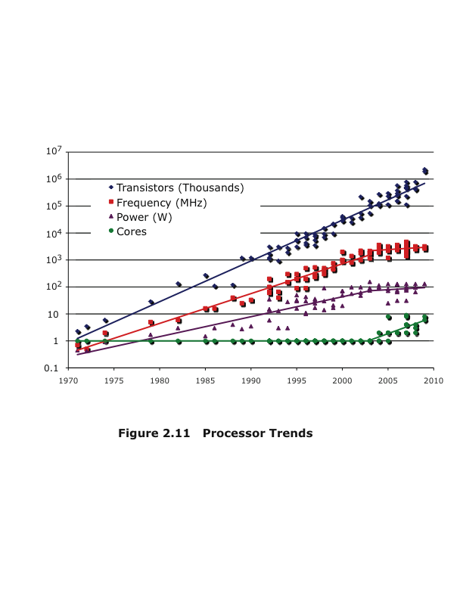
Problems With Clock Speed And Login Density

Slide 37
Multicore, MICs and GPGPUs
Multicore
  The use of multiple processors on the same chip provides the potential to increase performance without increasing the clock rate
  Strategy is to use two simpler processors on the chip rather than one more complex processor
  With two processors larger caches are justified
  As caches became larger it made performance sense to create two and then three levels of cache on a chip

Slide 38
Multicore, MICs and GPGPUs
Many Integrated Core (MIC)集成众核
  The Leap in performance as well as the challenges in developing software to exploit such a large number of cores
  The multicore and MIC strategy involves a homogeneous collection of general purpose processors on a single chip

Slide 39
Multicore, MICs and GPGPUs
Graphics Processing Unit (GPU)
  Core designed to perform parallel operations on graphics data
  Traditionally found on a plug-in graphics card, it is used to encode and render 2D and 3D graphics as well as process video
  Used as vector processors for a variety of applications that require repetitive computations
  A GPU can support a broad range of applications --- GPGPU
    Deep learning

Slide 40
Embedded System and the ARM
Embedded System
  Def.： A combination of computer hardware and software, and perhaps additional mechanical or other parts, designed to perform a dedicated function.
  In many cases, embedded systems are part of a larger system or product, as in the case of an antilock braking system in a car.

Slide 41
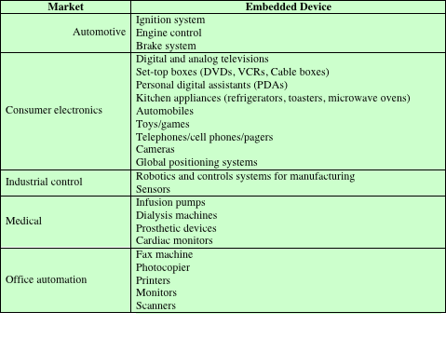
Examples of Embedded Systems and Their Markets

Slide 42
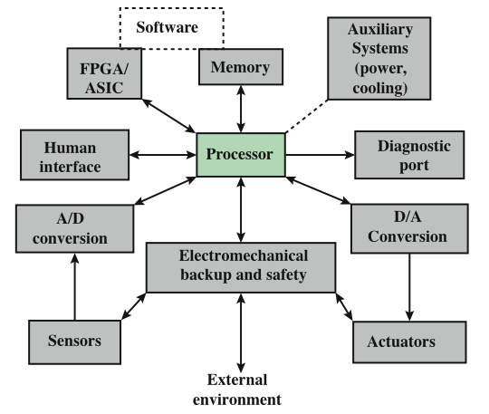
Possible Organization of an Embedded System

Slide 43
Embedded System and the ARM
Acorn RISC Machine (ARM)
  Family of RISC-based microprocessors and microcontrollers
  Designs microprocessor and multicore architectures and licenses them to manufacturers
  Chips are high-speed processors that are known for their small die size and low power requirements
    Widely used in PDAs and other handheld devices
  Most widely used processor architecture of any kind

Slide 44
ARM Evolution
Family | Notable Features | Cache | Typical MIPS @ MHz
ARM1 | 32-bit RISC | None
ARM2 | Multiply and swap instructions; Integrated memory management unit, graphics and I/O processor | None | 7 MIPS @ 12 MHz
ARM3 | First use of processor cache | 4 KB unified | 12 MIPS @ 25 MHz
ARM6 | First to support 32-bit addresses; floating-point unit | 4 KB unified | 28 MIPS @ 33 MHz
ARM7 | Integrated SoC | 8 KB unified | 60 MIPS @ 60 MHz
ARM8 | 5-stage pipeline; static branch prediction | 8 KB unified | 84 MIPS @ 72 MHz
ARM9 |  | 16 KB/16 KB | 300 MIPS @ 300 MHz
ARM9E | Enhanced DSP instructions | 16 KB/16 KB | 220 MIPS @ 200 MHz
ARM10E | 6-stage pipeline | 32 KB/32 KB
ARM11 | 9-stage pipeline | Variable | 740 MIPS @ 665 MHz
Cortex | 13-stage superscalar pipeline | Variable | 2000 MIPS @ 1 GHz
XScale | Applications processor; 7-stage pipeline | 32 KB/32 KB L1 512 KB L2 | 1000 MIPS @ 1.25 GHz

Slide 45
Performance Assessment
Clock frequency
  Operations performed by a processor are governed by a system clock
  Speed of processor is dictated by the pulse frequency by the system clock, measured in cycles per second(Hz) --- clock frequency
    imprecise
Processor time T
  Time needed that a processor execute a given program
  T= CPU clock cycles for a program *clock cycle τ
  = CPU clock cycles for a program/clock rate
  T= CPI ×I_{C} × clock cycle τ = CPI ×I_{C} / clock rate
  CPI: average cycles per instruction
  I_{C}: instruction count
  Influenced by the instruction set architecture, compiler technology, processor implementation and memory hierarchy

Slide 46

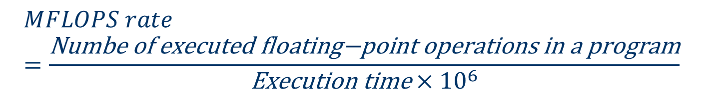
Performance Assessment
Processor Speed
  rate at which instructions are executed, expressed as millions of instructions per second (MIPS)
    referred to as the MIPS rate
  millions of floating-point instructions per second (MFLOPS)
    For scientific and game application
  inadequate

Slide 47
Performance Assessment
Benchmark suite
  A collection of programs, defined in a high-level language
  Attempts to provide a representative test of a computer in a particular application or system programming area
Desirable characteristics of a benchmark
  Written in a high-level language, making it portable across different machines
  Representative of a particular kind of programming style
    systems programming, numerical programming, or commercial programming
  Measured easily
  Wide distribution

Slide 48
Performance Assessment
  SPEC (Standard Performance Evaluation Corporation)
  An industry consortium
  Defines and maintains the best known collection of benchmark suites
  Performance measurements are widely used for comparison and research purposes
SPEC CPU2006
  Best known SPEC benchmark suite
  Industry standard suite for processor intensive applications rather than I/O
  Consists of 17 floating point programs written in C, C++, and Fortran and 12 integer programs written in C and C++
  Suite contains over 3 million lines of code

Slide 49
Performance Assessment
Amdahl Law
  The improved performance of using a faster execution mode is limited by the fraction of the execution time of faster mode in total execution time
  The improved performance is limited by the frequency of using a faster mode
  Amdahl Law defines speed-up that can be gained by using a particular technology
Speedup
  the ratio
  The performance using enhancements/the performance without using enhancements
  Execution time for entire task without using the enhancement/execution time for entire task using the enhancement

Slide 50
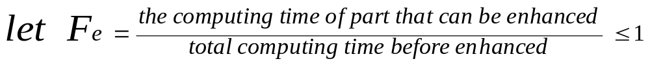
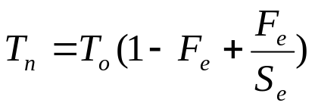
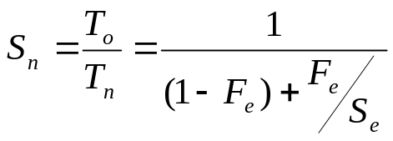
Speedup of system
Amdahl’s Law gives us a quick way to find the speedup from some enhancement
  We can get:
    Execution time of total task after enhancement:
    System speed-up after enhancement:
Relation between system speed-up and Fe
  When F_{e}=0, S_{n}=1, this means no part can be enhanced
  When S_{e}=∞, S_{n}=1/(1-F_{e})
  So, the system performance enhancement is strongly limited by F_{e}

Slide 51
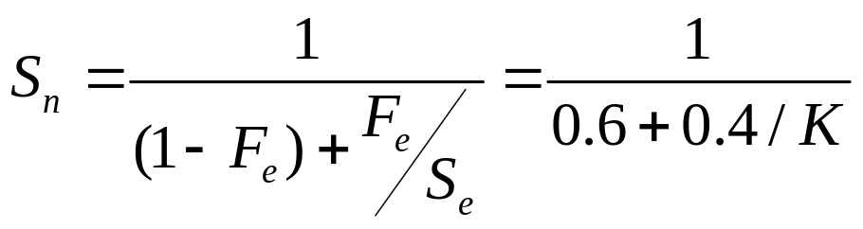
An example
Suppose that a task makes extensive use of floating-point operation, with 40% of the time is consumed by floating-point operations. With a new hardware design, the floating-point module is speeded up by a factor of K. what is the overall speedup gained by this enhancement?
  Solution: Fe=0.4,Se=K, according to Amdahl Law:
  Se= ∞, Sn=1.67

Slide 52
Vocabulary
Pipelining and parallel execution: 流水与并行执行
Speculative execution: 推测执行
Cache: 快速缓存
Decimal: 十进制
Binary: 二进制
General purpose computer: 通用计算机
Von Neumann Machine: 冯-诺依曼计算机
Opcode=operation code: 操作码
Instruction cycle: 指令周期
Fetch cycle: 取（读）周期

Slide 53
Vocabulary
Flowchart: 流程图
Condition branch: 条件转移
Data transfer: 数据传送
Upward compatible: 向上兼容
Multiplexor: 复用器
Bus: 总线
Magnetic-core memory: 磁芯存储器
End user: 端用户
Speech recognition: 语音识别
Videoconferencing: 视频会议

Slide 54
Vocabulary
Multimedia authoring: 多媒体编著
Workstation: 工作站
Client-server: 客户机-服务器
DRAM—dynamic random access memory: 动态随机存取存储器
Branch prediction: 转移预测
Throughput: 吞吐率
Trade-off : 折衷
Supercomputer: 超级计算机/巨型机
Parallelism: 并行性

Slide 55
Key points
  What is the first computer in the world?
  What features of von Nuemann machine is there? How about its structure?
  Moore law?
  What is multicore, MICs and GPU?
  CPI, I_{c}, T, MIPS, MFLOPS
  Amdahl Law

Slide 56
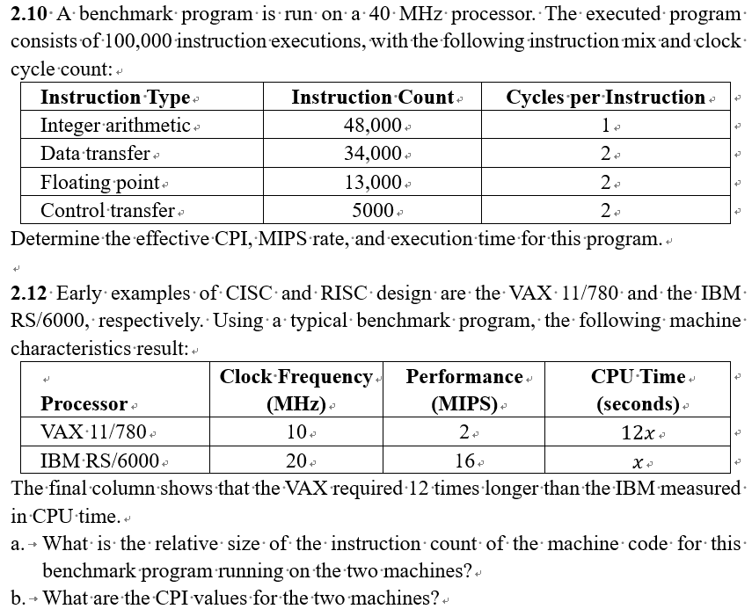
Homework
  P84 2.10 and 2.12

